Slide 1

Binary/Decimal Conversions
Number Bases
Grouping to Convert
Conversion Algorithms
Hands-on with Python
Notes:
Let’s have a quick lesson on binary / decimal conversions.
First, we’ll look at number bases in general and see how to represent numbers in any base.
Then we’ll look at two generic algorithms: one to convert decimal TO binary and one to convert FROM binary back to decimal.
Finally, we’ll code up the decimal-to-binary conversion in python.
-------
Online python interpreter: https://www.online-python.com/

Slide 2
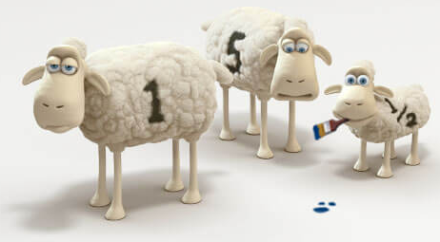
See Also
https://www.cuemath.com/numbers/base/
https://www.binaryhexconverter.com/binary-to-decimal-converter
https://www.youtube.com/watch?v=VLflTjd3lWA
Notes:
Here is some additional learning on the web. You’ll find these links n the class notes.

Slide 3
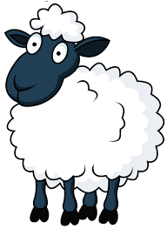
Powers of BASE
8
4
2
1
1000
100
10
1
10³
10²
10¹
10⁰
2³
2²
2¹
2⁰
1
3
1
1
0
1
343
49
7
1
4096
256
16
1
7³
7²
7¹
7⁰
16³
16²
16¹
16⁰
1
6
D
Notes:
How many sheep do we have? I’ll count them on my fingers …6, 7 , 8, 9 10. I ran out of fingers. I could take off my shoes off use my toes, but I’ll just remember I got to 10 and start over … 1, 2, 3.
10 + 3 … that’s 13. That’s counting in decimal – base 10 – which is what we’ve been doing since before kindergarten. Ten digits. The numbers 0 through 9, because we have 10 fingers.
# 1 Early in grade school we learned to write numbers in decimal. Each digit is a higher power of 10.
# 2 13 sheep. That’s one full group of ten plus 3 left over.
There is nothing special about base 10. You use other base systems every day. There are 12 inches in a foot. Time and angles are base 60 (sexagesimal instead of decimal). There are 60 seconds in a minute – 60 minutes in an hour.
# 3 How about base-7 where each digit is a power of seven instead of a power of 10? You count with 6 digits 0-6 and then you carry a one into the 7’s column. Just like base 10, but with a different grouping.
# 4 Our sheep. One complete group of 7 with 6 remaining. That’s 13 in base 7.
Computers have two fingers. Deep in the logic circuits, the voltage is either on or off mapping to Boolean states true or false.
# 5 We call base two “binary”. Numbers are written with just two digits -- powers of 2. Each column is a power of 2 instead of power of 10, but the rules are the same. Count to 1 in each column and then carry a one into the next column.
#6 Our sheep are divided into one group of 8 plus a group of 4 more – that’s 12 – and a single sheep remaining.
-----
There are number bases with more than 10 digits.
# 7 Hexadecimal is common in computer science because. Base 16 – there are 16 digits. 0 through 9, and then we have to use other characters. Hex uses A for 10, B for 11, C, D, E, and F for 15.
Back to our sheep. 13 fits in a single hex digit.
# D=12. I have to count it out on my fingers 10, 11, 12 13 (four) A, B, C, D.

Slide 4
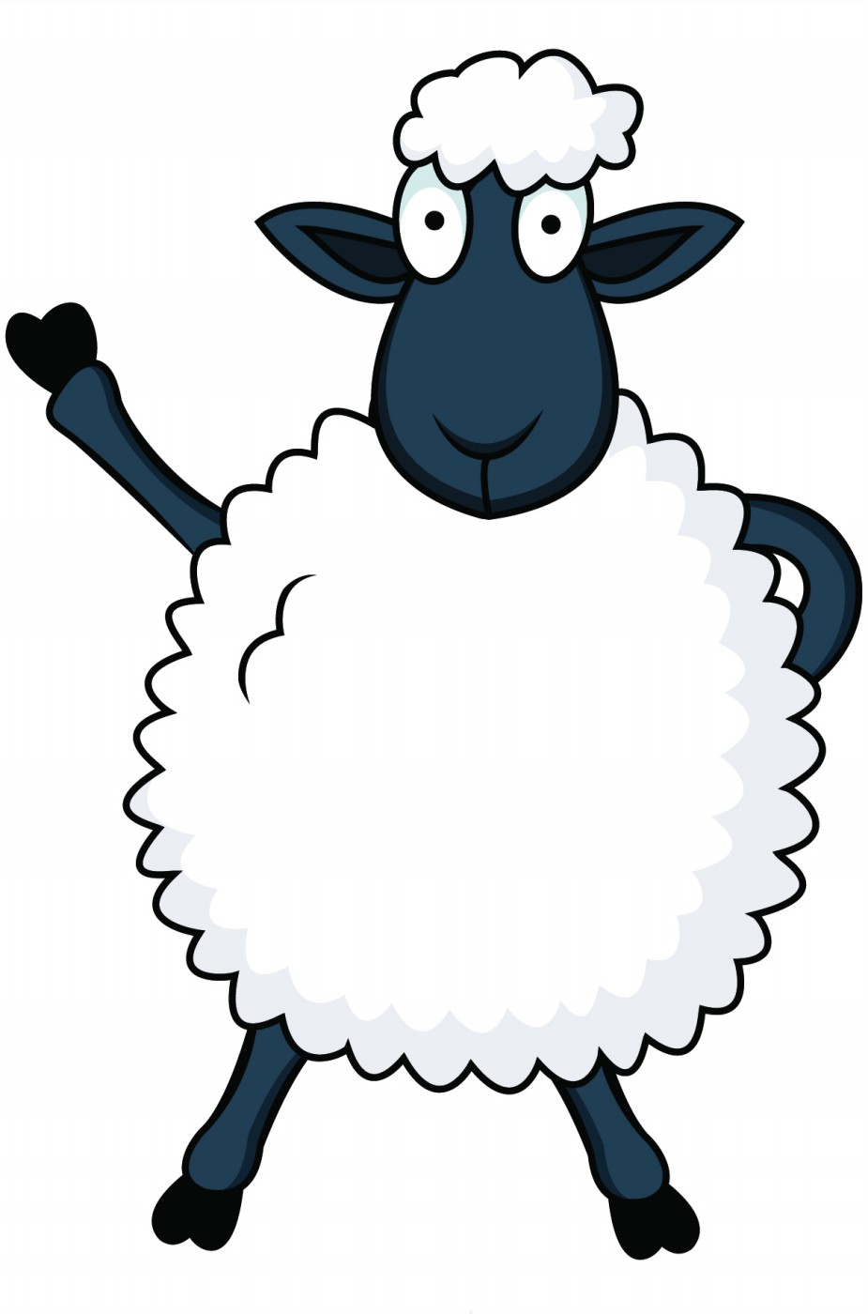
Binary to Decimal
Binary
Decimal
128
64
32
16
8
4
2
1
2⁷
2⁶
2⁵
2⁴
2³
2²
2¹
2⁰
11 =
3
1
1
0
1
0
1
0
1
100 =
4
128*1
+ 64*1
+ 16*1
+ 4*1
+ 1*1
1010 =
10
213
9
1001 =
1111 =
15
Notes:
The computer is great about converting its inner storage to decimal for us. But what if it you could crack open a memory chip and see that computer has counted 11010101 (in binary) sheep? How many is that in human – decimal?
#1 Each digit is a successive power of 2.
#2 Thus the values of the columns are multiples of 128, 64, 32, and so on.
To convert binary to decimal, multiply the values by the digits. For binary the digits are either 1 or 0. So.
#3, #4, #5, #6, #7
Add those up and you get …
#8 213
#9 Let’s do some practice
#10, 11 12 13 14
Converting to decimal from binary (or any base) takes multiplication and addition.

Slide 5
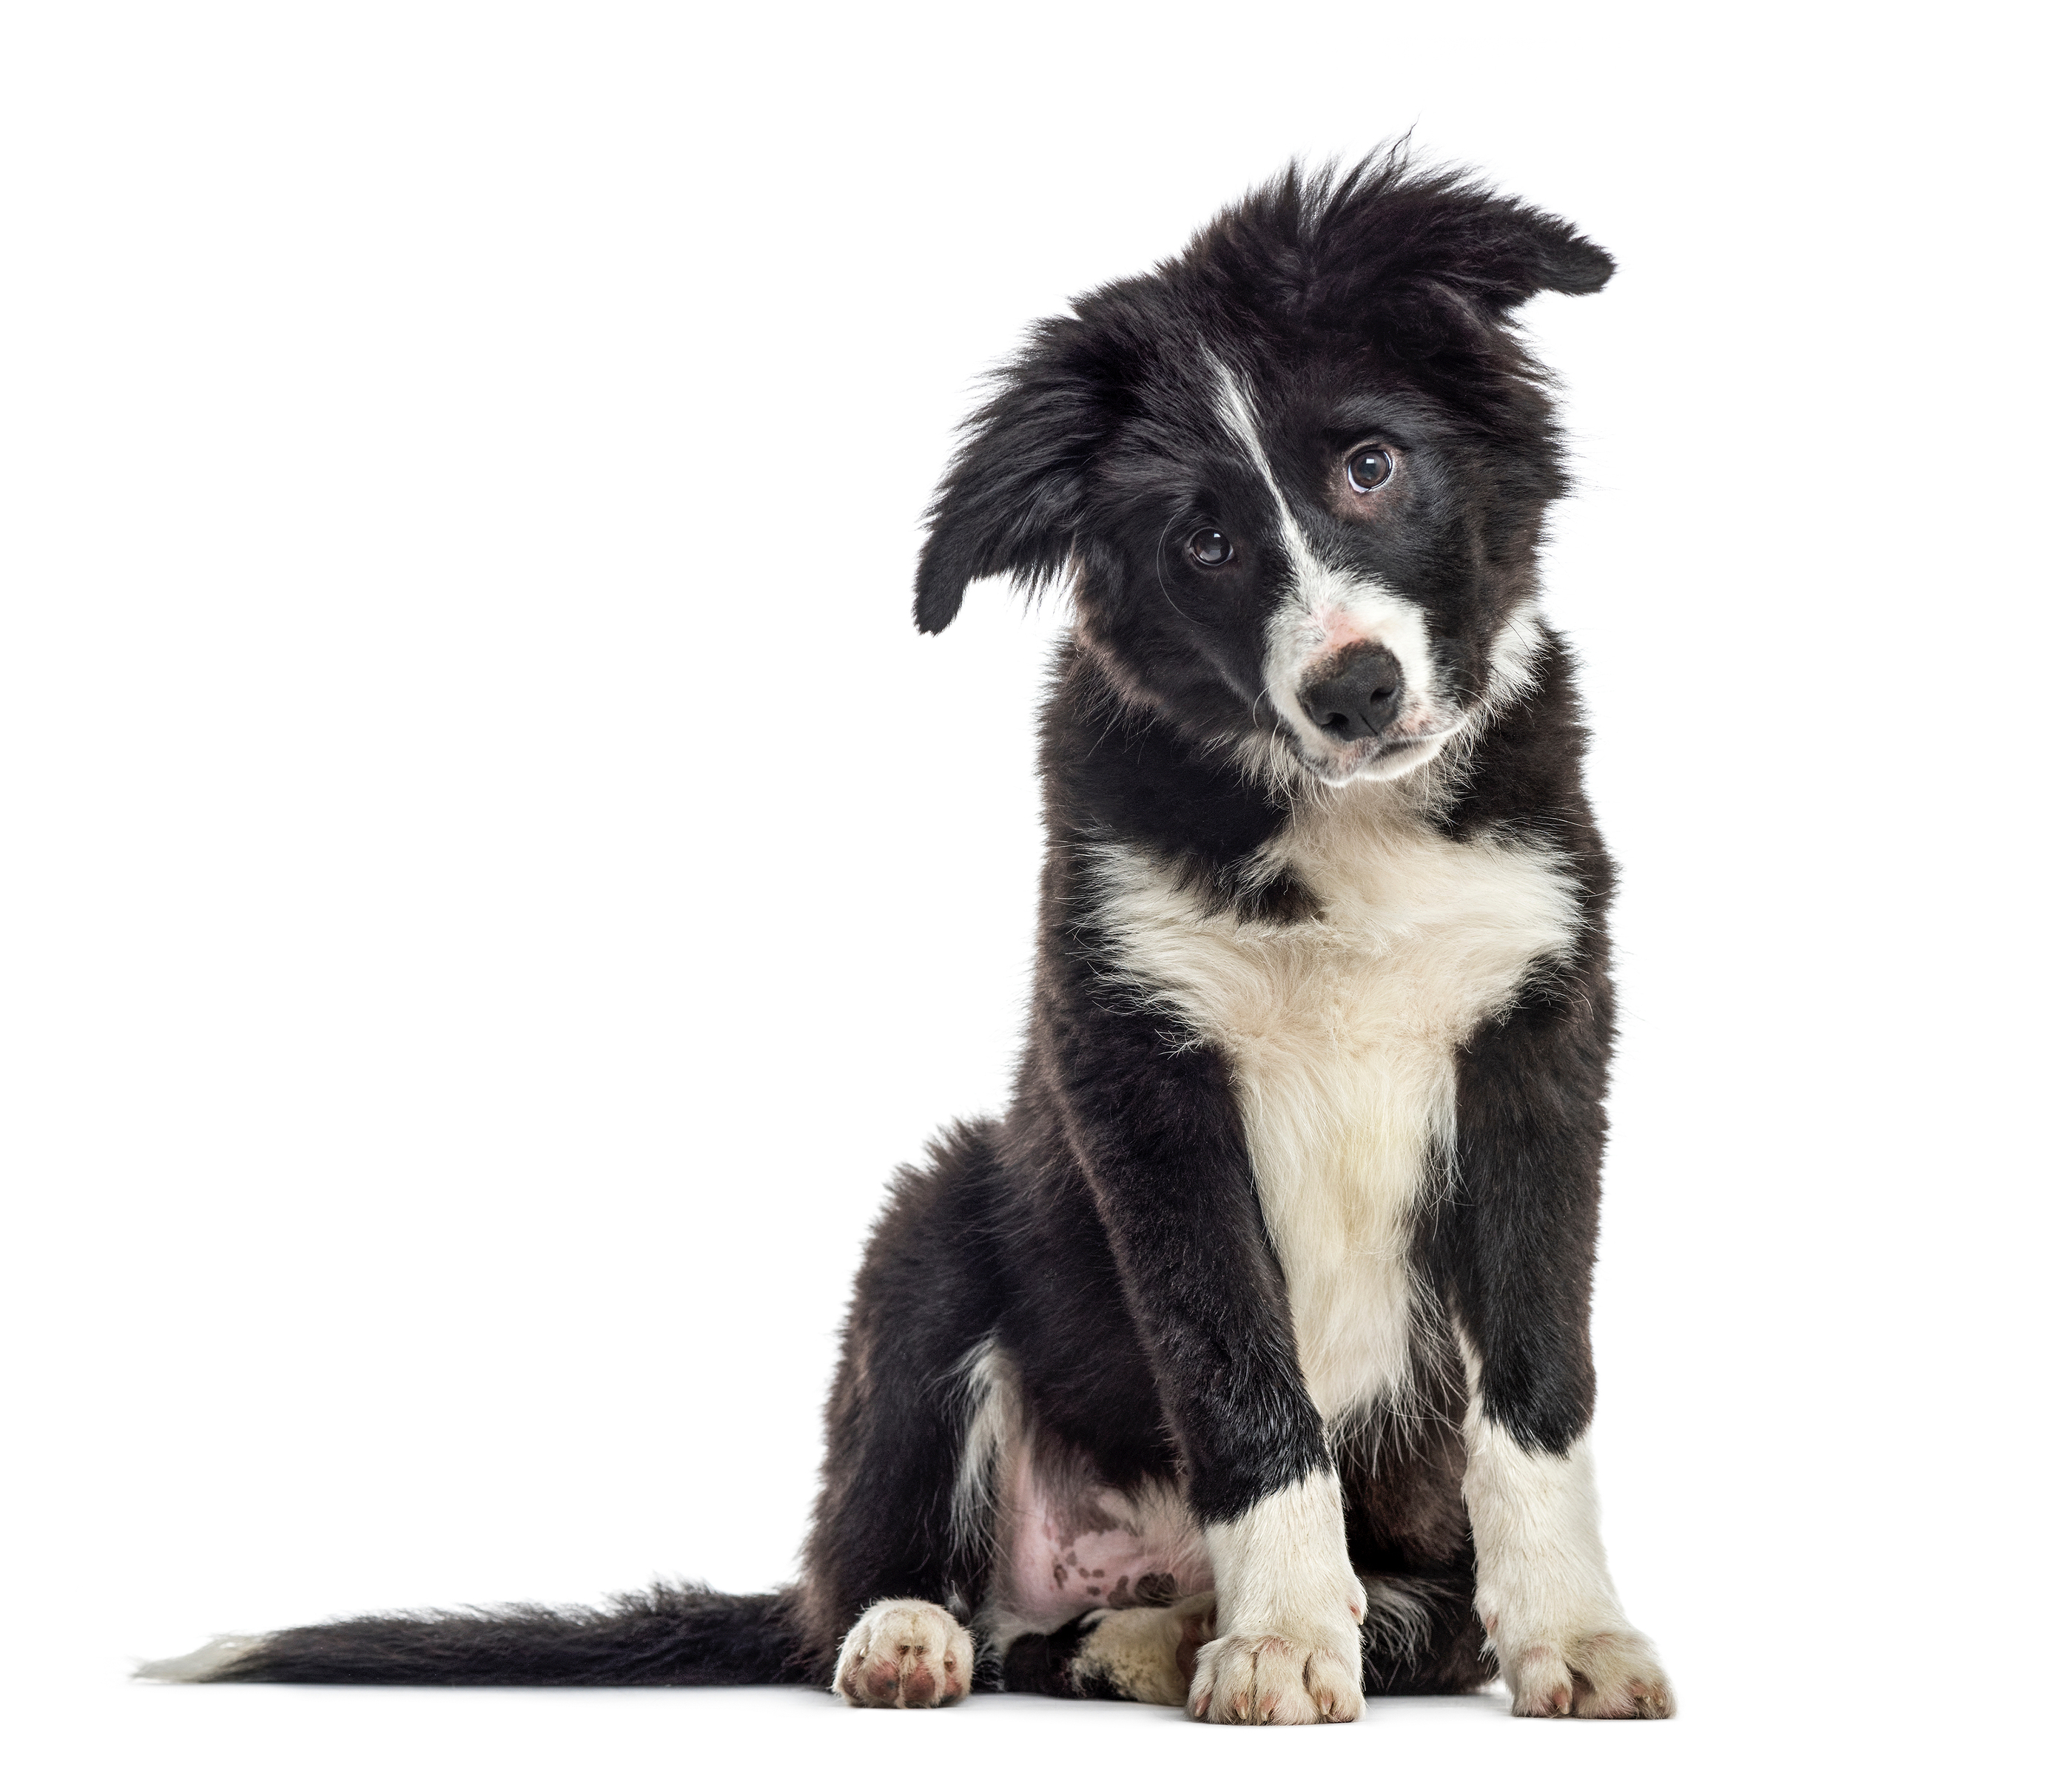
Binary to Decimal
6 Groups plus 1 remaining.
? 1
Notes:
Going the other way – from decimal to another base – takes division and subtraction. We group things together and look for remainders.
First, we group our sheep into groups of two, which is much easier with a border collie
#2 13 divided into groups of two is 6 whole groups of two with one left over.
#3 The remainder becomes the right-most digit, and the dividend becomes the left-most digit
But the value 6 is not a valid binary digit. What do we do? We continue grouping and break the “6” up into a left and right digit.

Slide 6
Binary to Decimal
3 Groups with 0 remaining.
?
? 0
1
Notes:
Here are our six groups.
#1 We group these up into three whole groups of two with none remaining.
#2 The 0 is our next digit. But three is still too big to fit in a binary digit. So we continue grouping.

Slide 7
Binary to Decimal
1 Group with 1 remaining.
?
1 1
0 1
Notes:
Here are our three groups.
#1 Dividing by two again, we get 1 group of 2 with a remainder of 1
#2 The remainder is the right digit, and the dividend is the left digit. And the dividend is a binary number, so we are through.
1101. 8+4+1=13. It checks out.

Slide 8

Hands-on
Notes:
Time to get our hands dirty!
This is a python programming class. How do we code this conversion algorithm up in python?

Slide 9
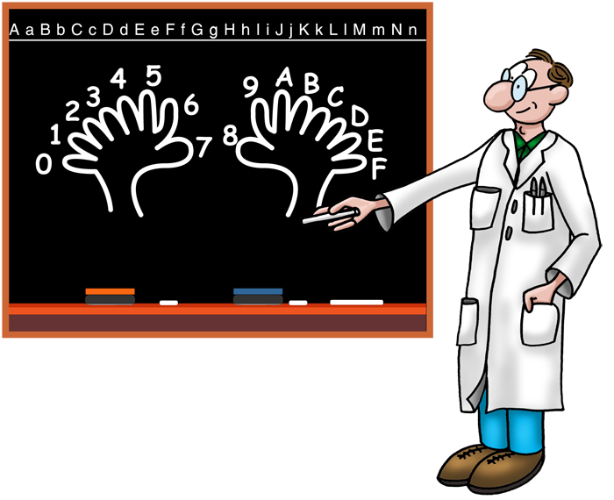
Your Turn
Write a function that takes the decimal VALUE and the BASE as arguments and returns a string representation of the value in the given base.
Write a function that takes a string VALUE and the BASE as arguments and returns the decimal value.

Slide 10
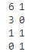
Hands-on
value = 13
remains = value % 2
groups = value // 2
print(groups,remains)
value = 13
while value>0:
remains = value % 2
value = value // 2
print(value,remains)

Slide 11

Hands-on
value = 13
result = ''
while value>0:
remains = value % 2
value = value // 2
# Prepend the remainder
result = str(remains) + result
print(result)

Slide 12
Beyond The Radix
1/2
1/8
8
4
2
1
1/4
2³
2²
2¹
2⁰
2⁻¹
2⁻²
2⁻³
.
1
1
0
1
1
0
1
8 + 4 + 1 + 0.5 + 0.125
13.625
Notes:
Before we close, I want to introduce you to the “radix point”.
#1 You know it in base 10 as the “decimal point”. In binary, it is called the “binary point”
#2 In any number base it separates the integer part on the left from the fractional part on the right
#3 The columns are still powers of two, but they are negative to the right of the radix point.
#4 In binary, that’s ½, ¼, 1/8, and so on
#5 So what’s this number? 13 from before + ½ and 1/8 …
#6 13.625 sheep
Point 625 sheep.
#7 That’s ½ and
#8 another 1/8.
Fractional sheep are
#6

